Slide 1
Data Provisioning Using Flat File Upload

Slide 2
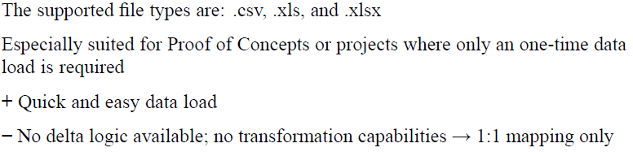
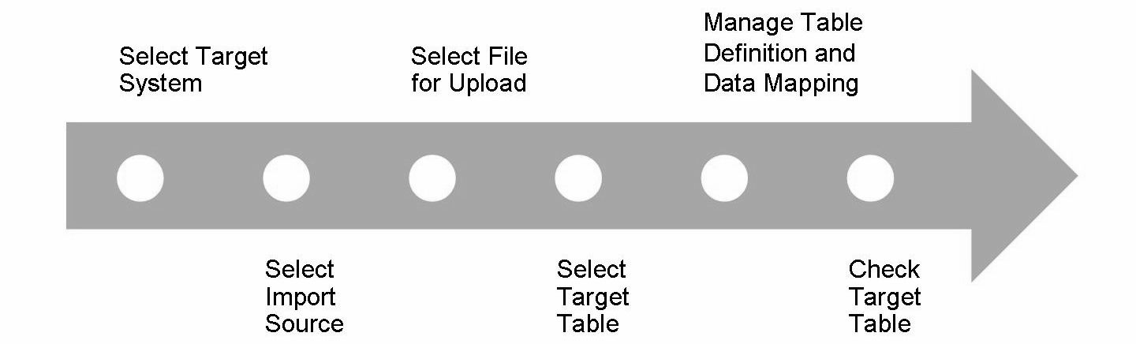
Process Flow: Uploading Data from Flat Files

Slide 3
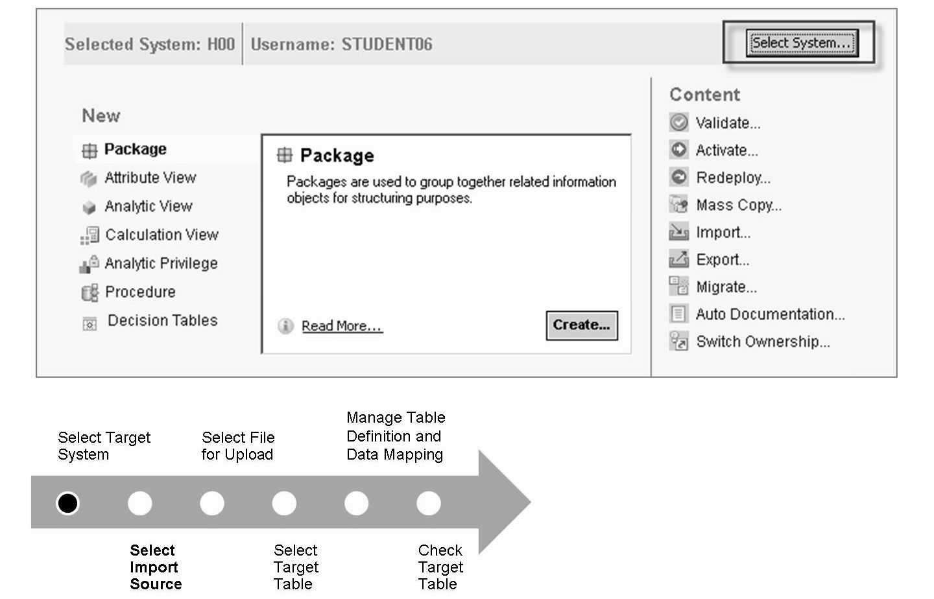

Slide 4
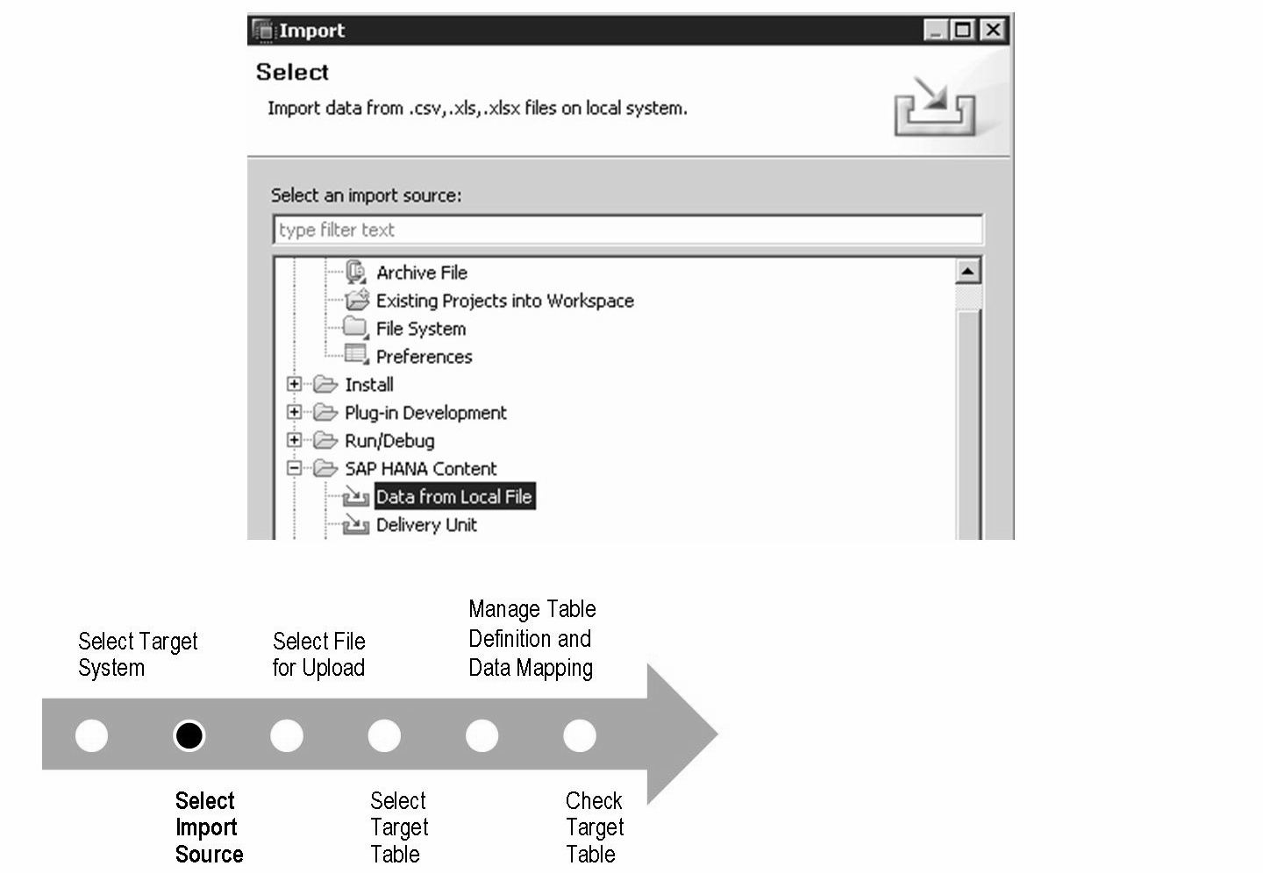

Slide 5
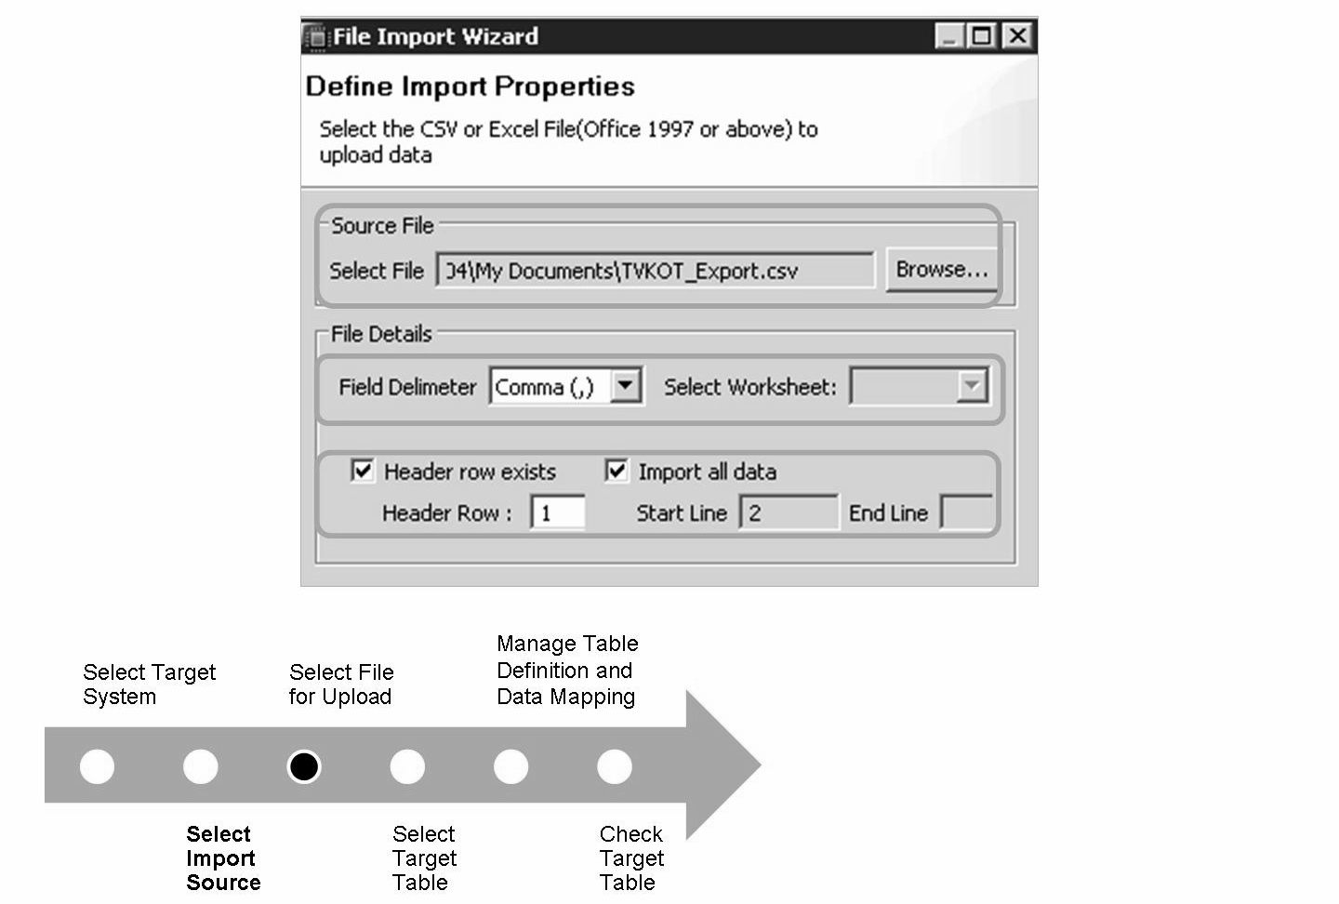

Slide 6
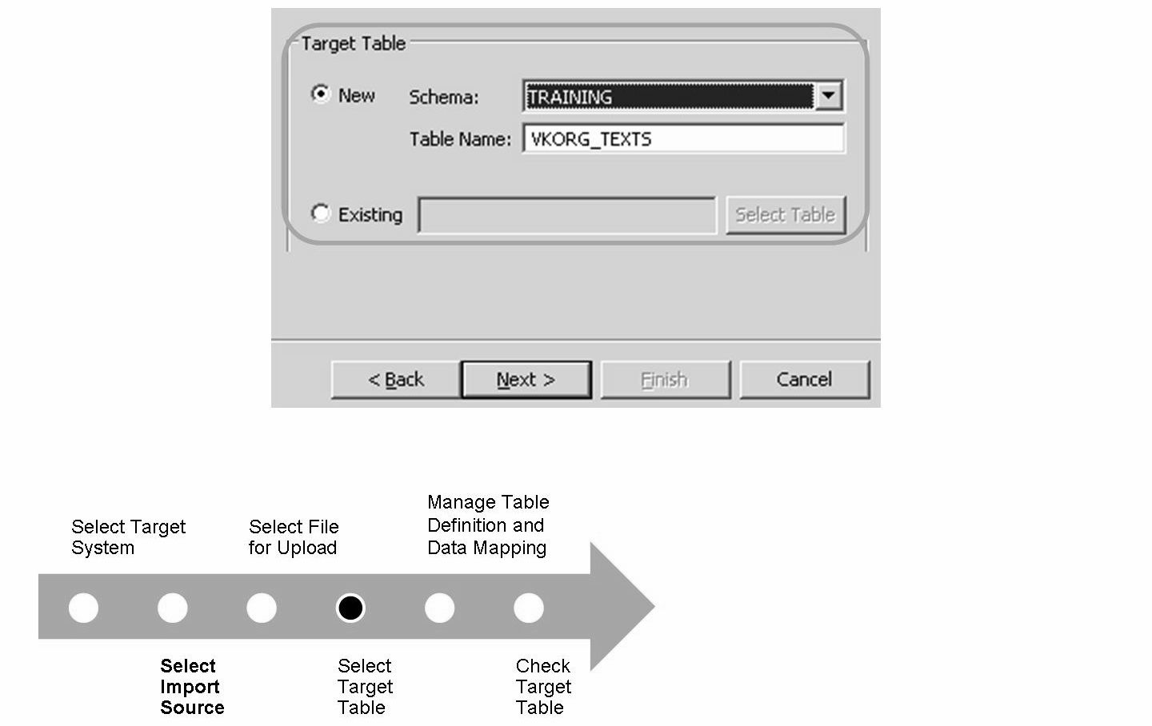

Slide 7
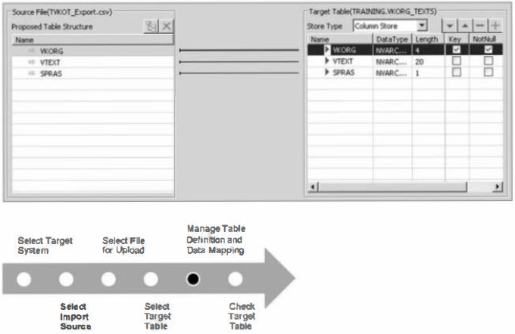

Slide 8
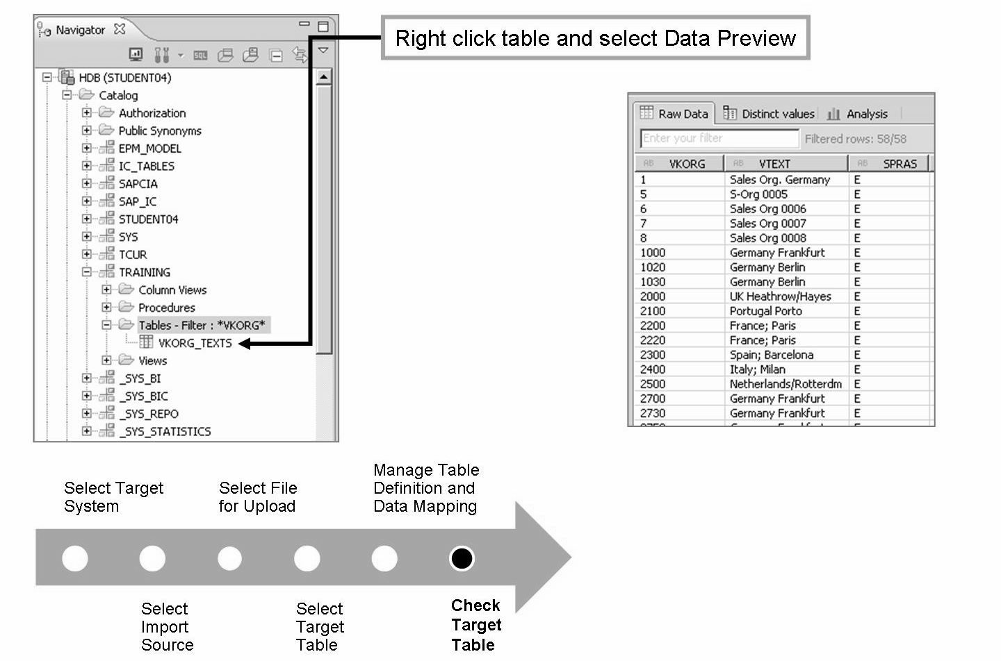

Slide 9
THANK YOU
Courtesy : SAP Labs Document -
HA 350 – Data Provisioning

